Slide 1
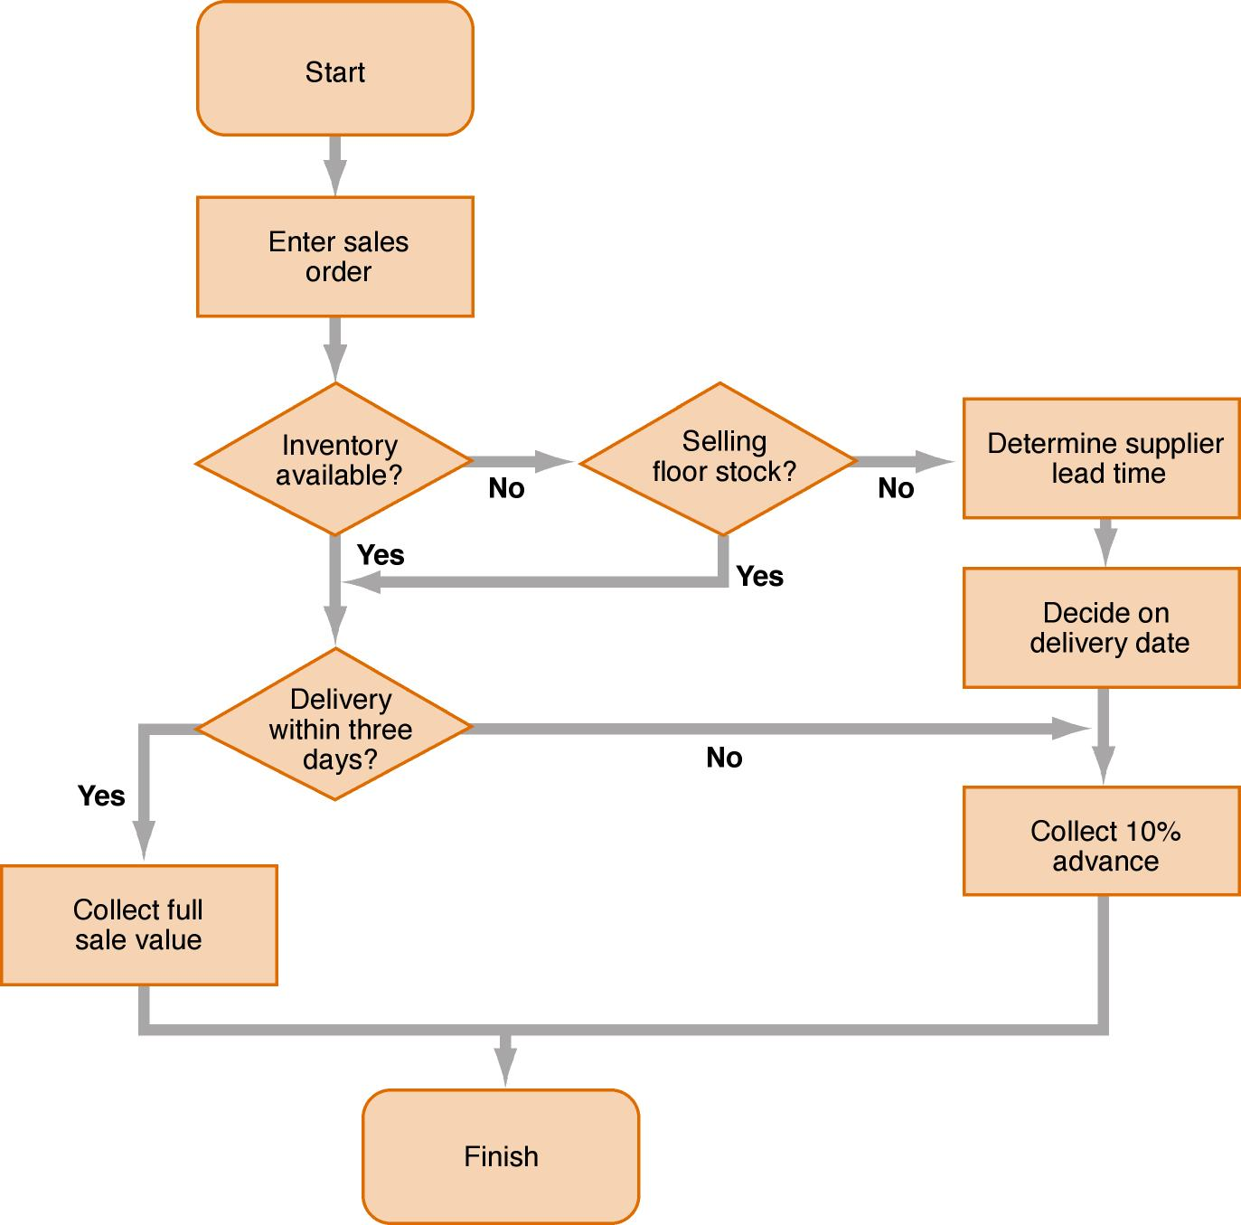
Program flow chart

Slide 2
Decision tables
The decision table tells us the following:
  if stock is not available and floor stock is not being sold, collect 10% advance
  if stock is available but delivery is not within three days, collect 10% advance
  if stock is available and delivery within three days, collect full value of sale
  if stock is not available but floor stock is being sold within three days, collect full value of sale
  if stock is not available but floor stock is being sold after three days, collect 10% advance

Slide 3
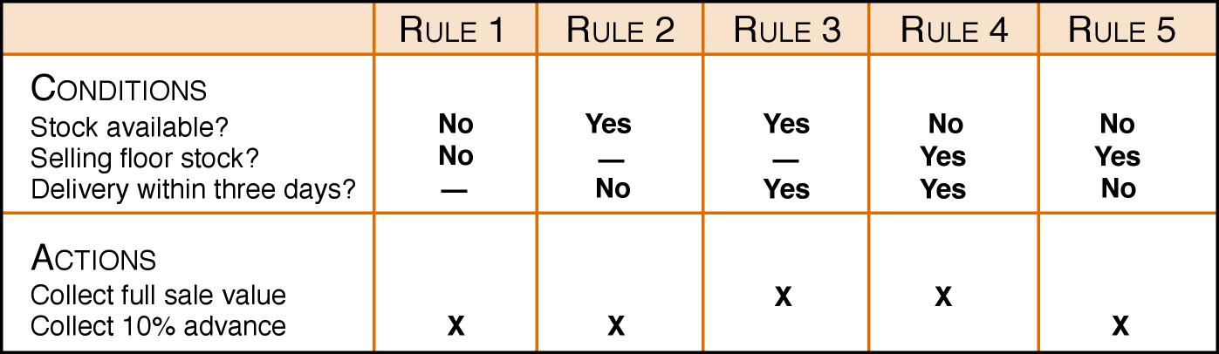
Decision table

